Slide 1
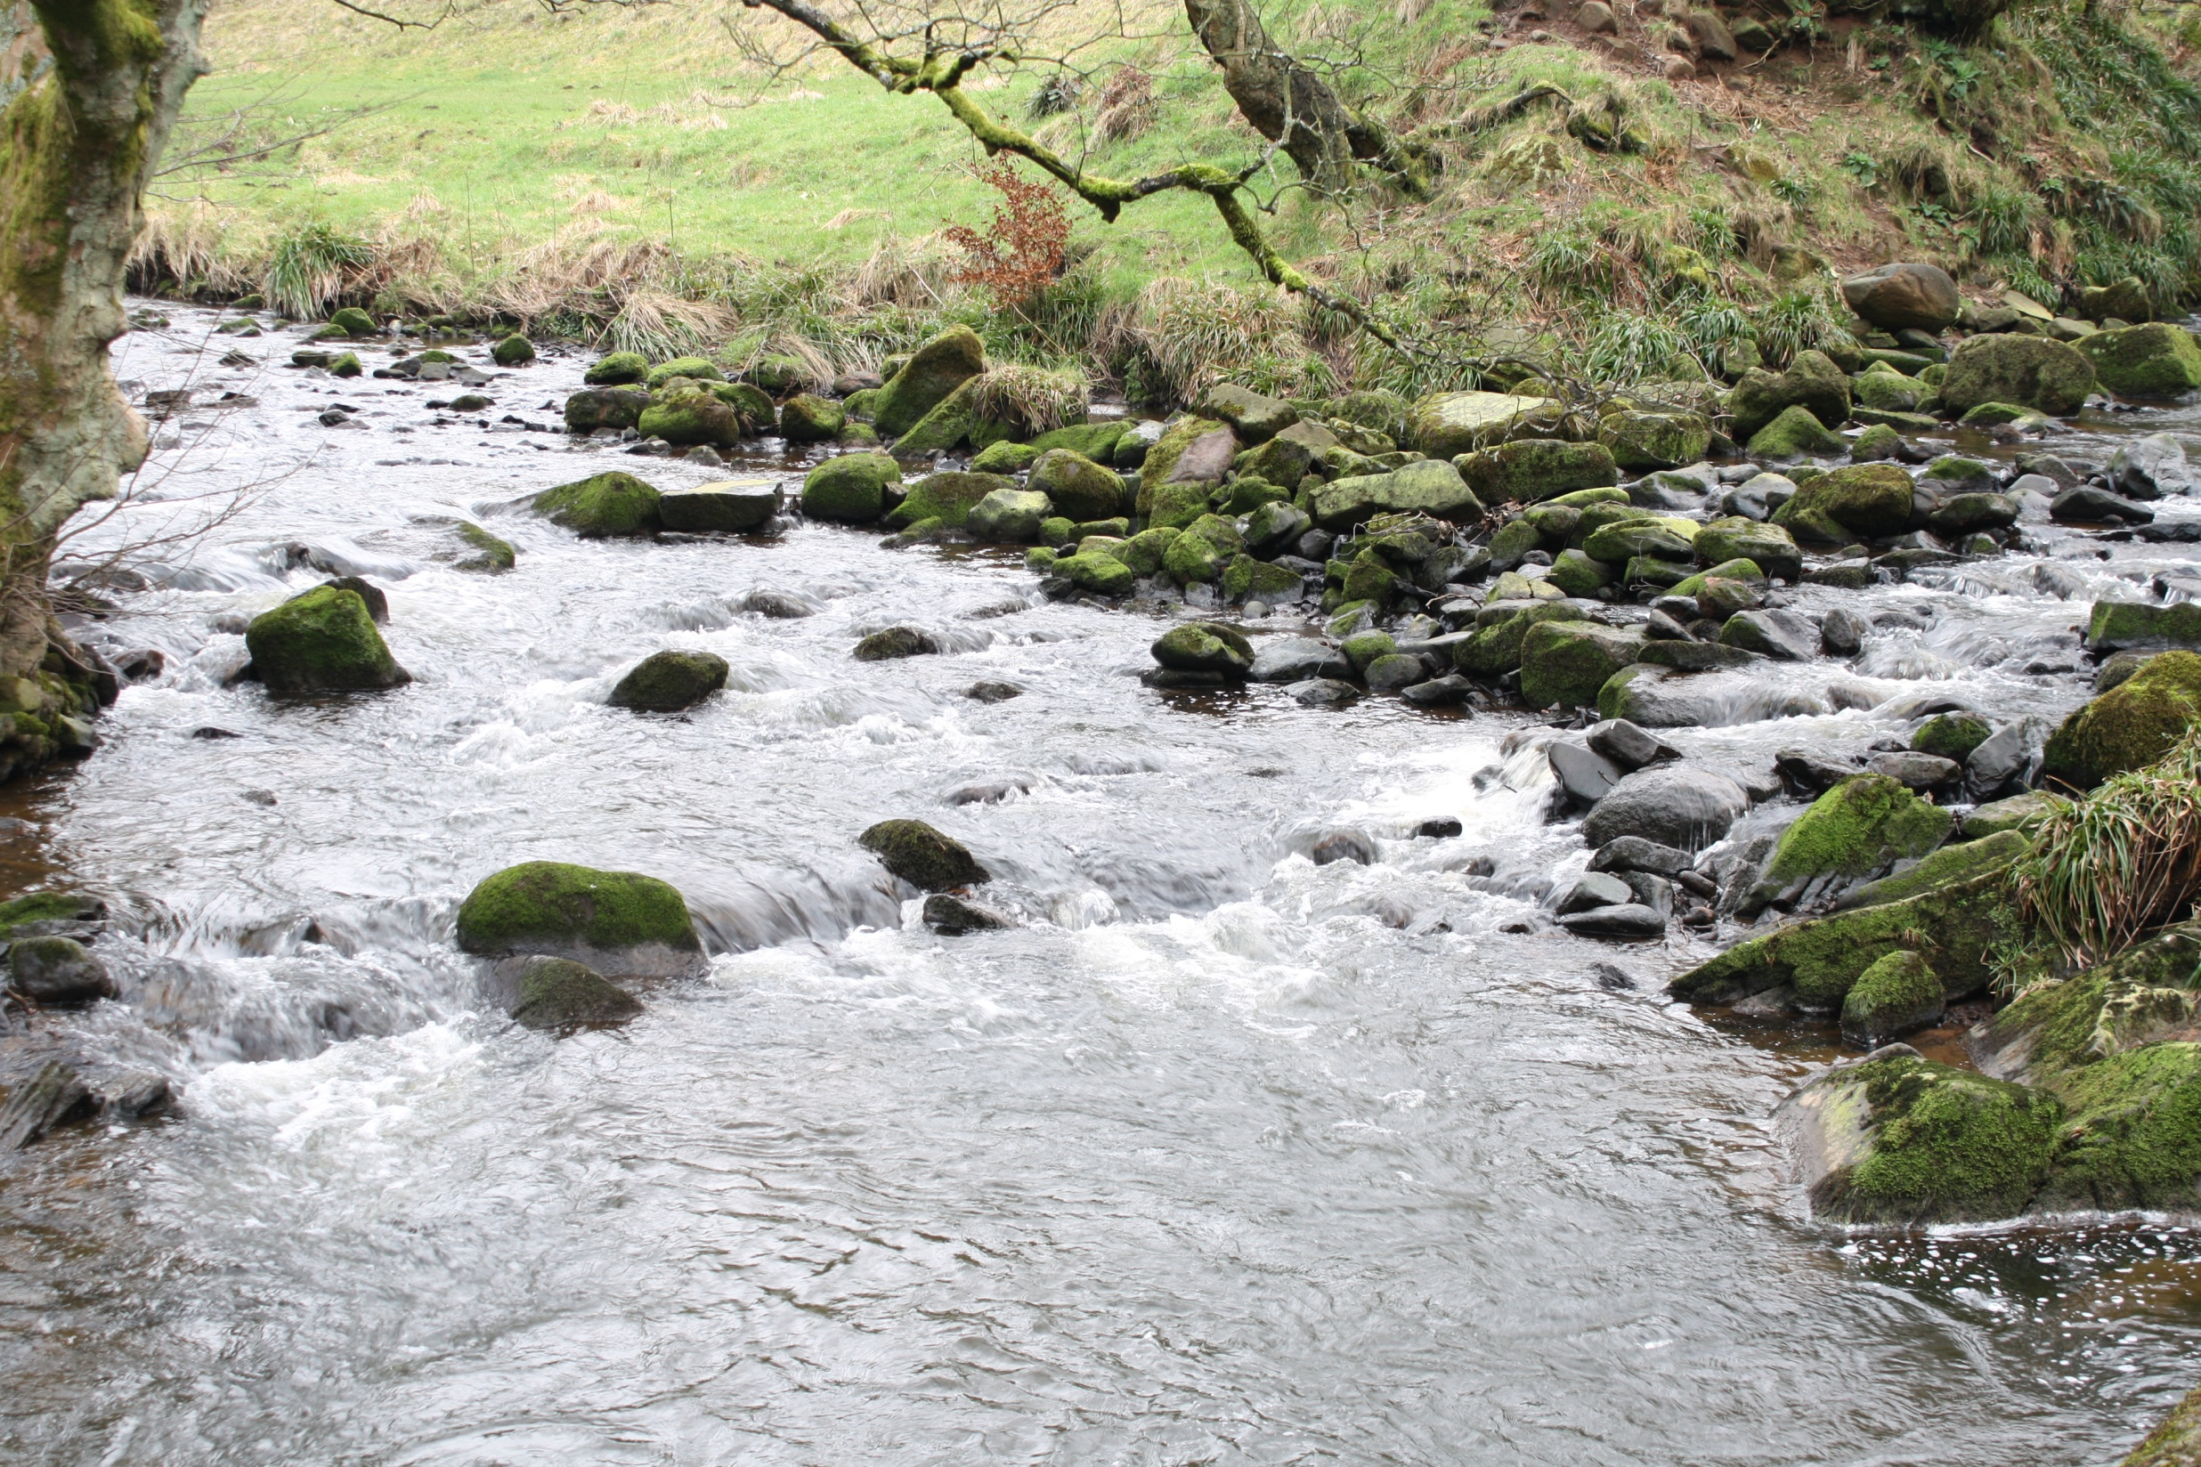
led me through water
that was ankle-deep

Slide 2
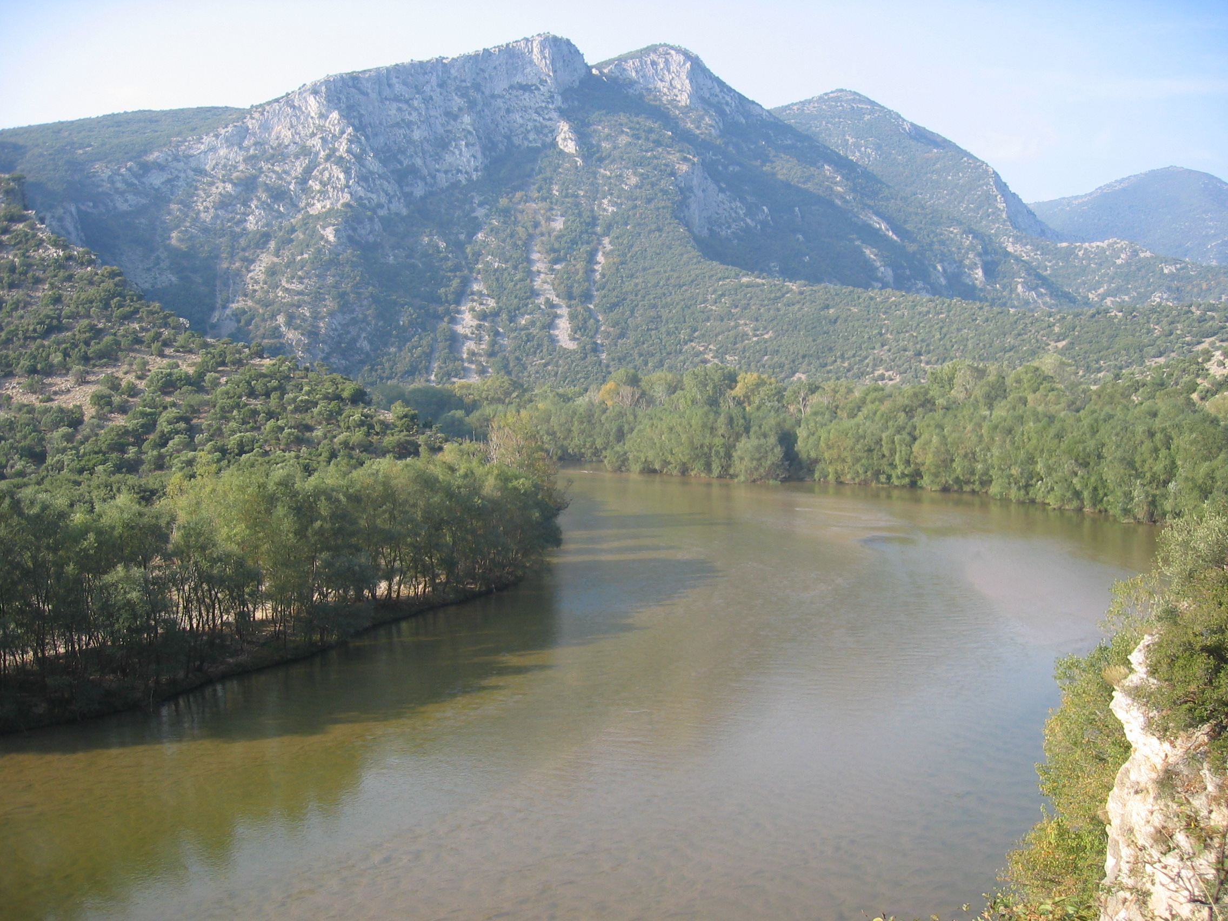
led me through water
that was knee-deep

Slide 3
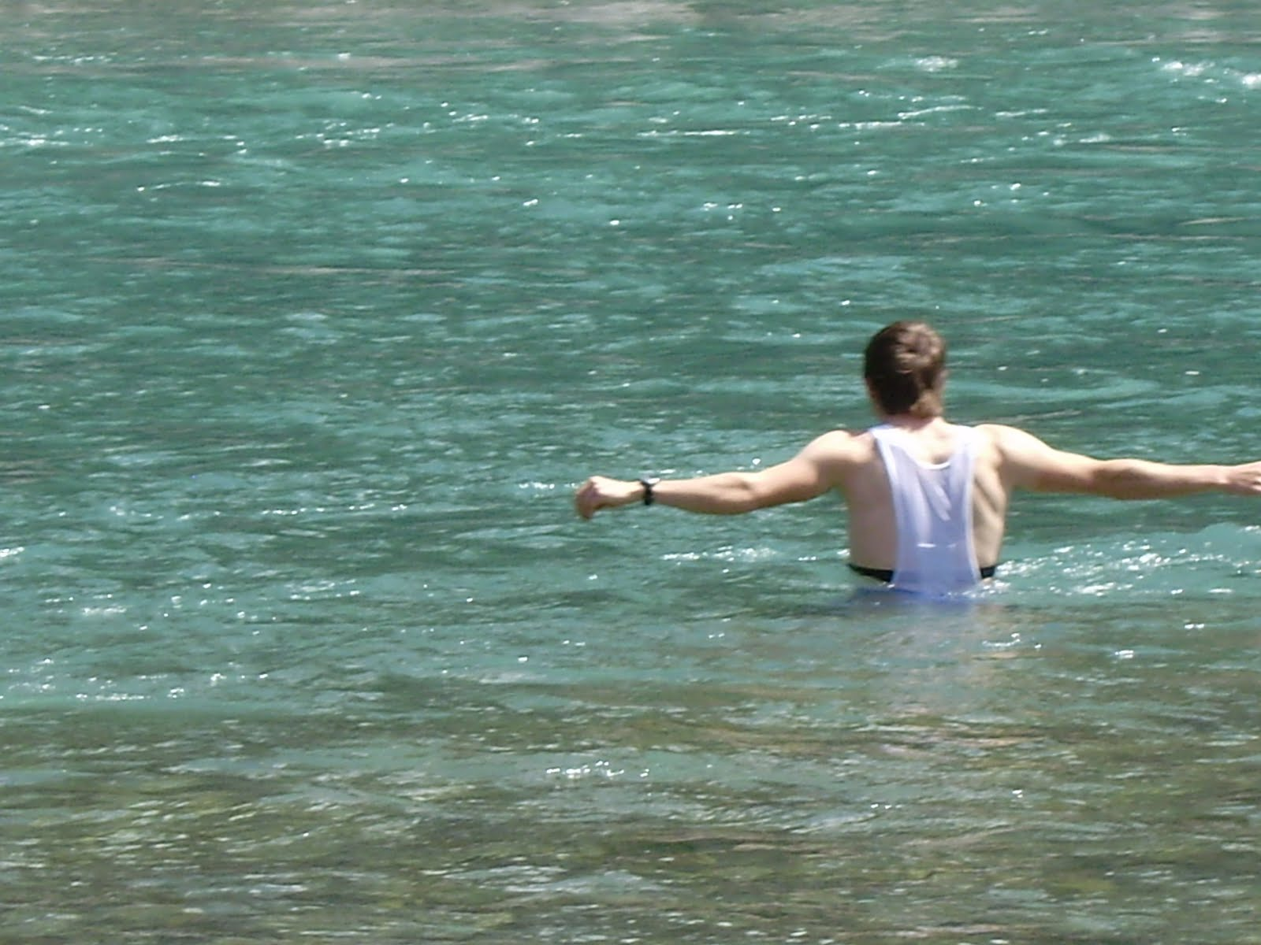
led me through water
that was up to the waist

Slide 4
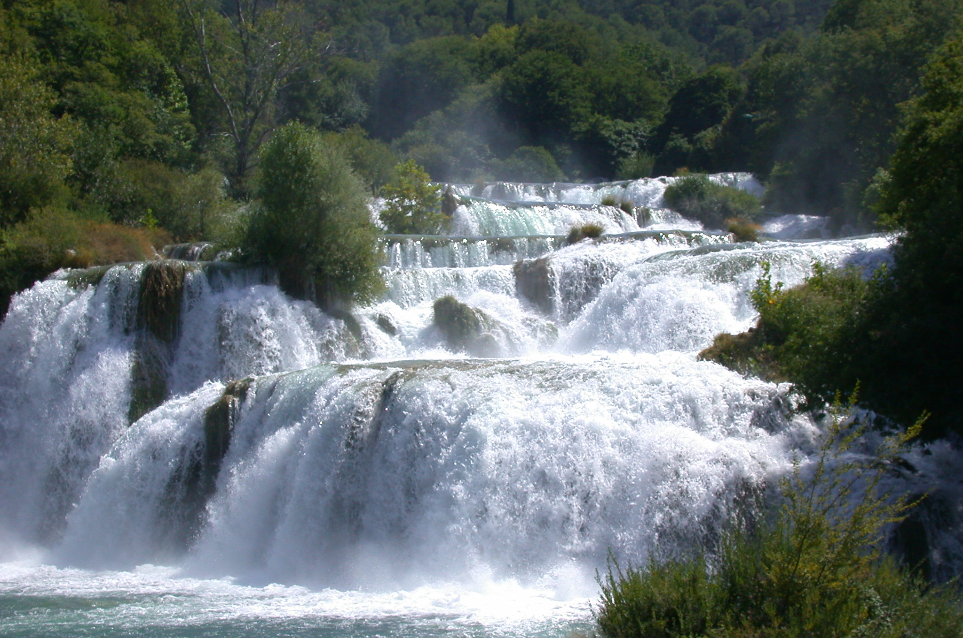
a river that no one could cross

Slide 5
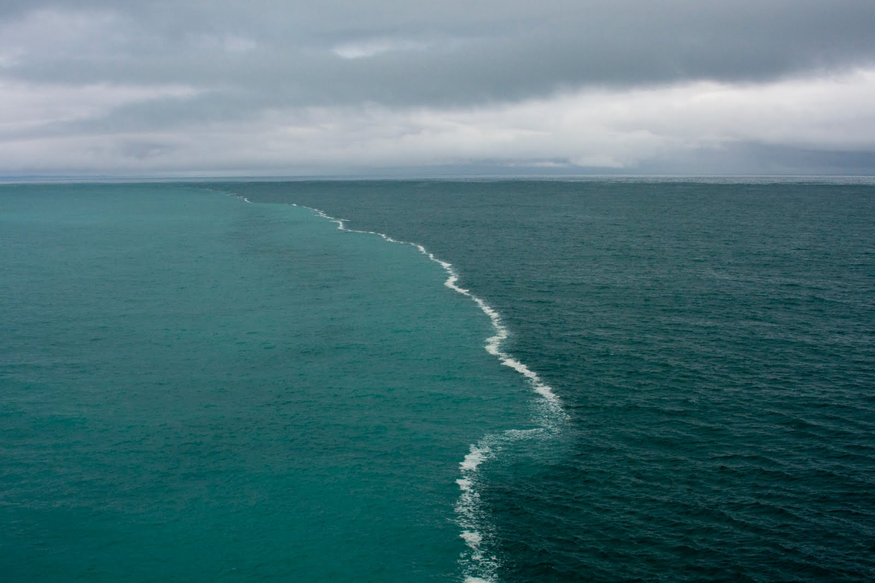
When it empties into the sea, the salty water there becomes fresh

Slide 6
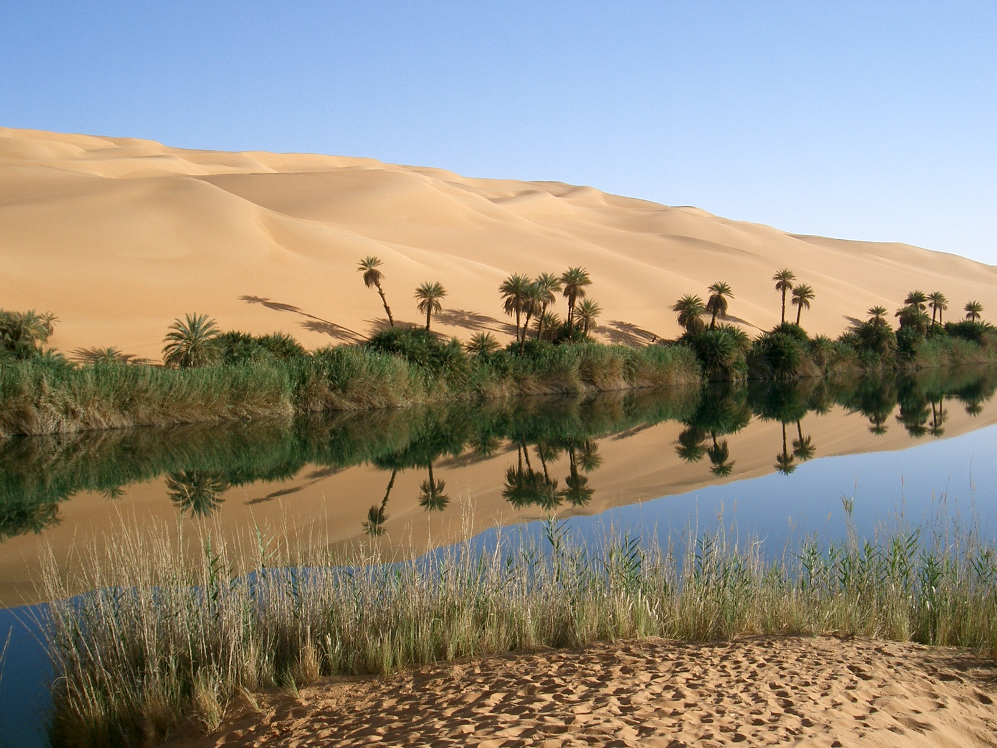
so where the river flows
everything will live

